Slide 1
CS2115 Computer Organization 2023/2024 Sem A
Chapter 9 Advanced Topics
(not included in final exam)
Dr. Nan Guan
Department of Computer Science
City University of Hong Kong

Slide 2
ASIC
Application-Specific Integrated Circuit (ASIC): an integrated circuit (IC) customized for a particular use, rather than intended for general-purpose use
E.g., audio/video decoder/encoder, network processing unit, Bluetooth module, GPS module, all kinds of device controllers …
More efficient in terms of speed, energy and cost compared with general-purpose processors
Only can do a specific job; not general-purpose

Slide 3
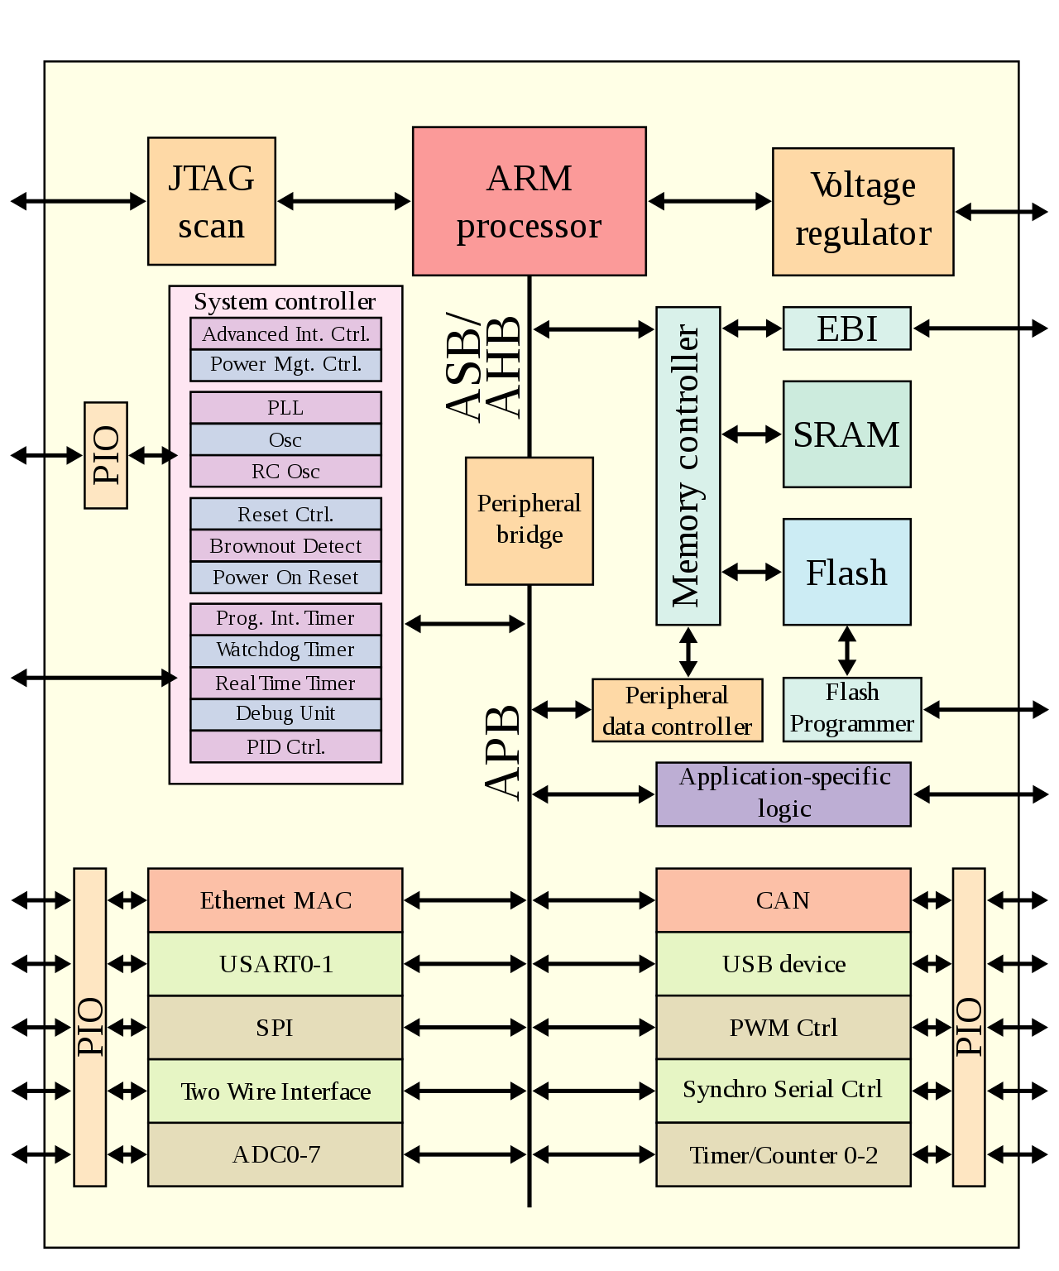
ASIC
ASIC in an SoC
All ASIC, except the ARM processor

Slide 4
FPGA
Field-Programmable Gate Array (FPGA): an integrated circuit (IC) designed to be configured by a customer or a designer after manufacturing – hence the term field-programmable
FPGAs contain an array of programmable logic blocks, and reconfigurable interconnects allowing blocks to be connected
Logic blocks can be configured to act as simple logic gates like AND and XOR, or jointly perform complex combinational functions
In most FPGAs, logic blocks also include memory elements, which may be simple flip-flops or more complete blocks of memory.

Slide 5
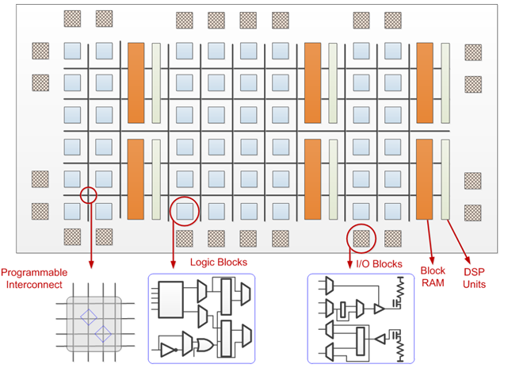
FPGA

Slide 6
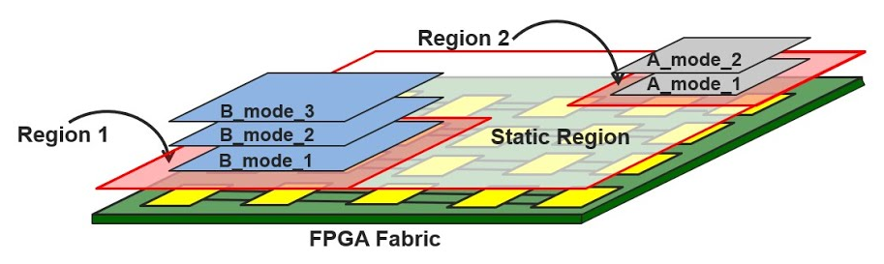
FPGA
Previously, FPGA is mainly used for fast prototyping in ASIC design
Modern FPGA is dynamically and partially reconfigurable
The functionality can be changed after the product is delivered

Slide 7
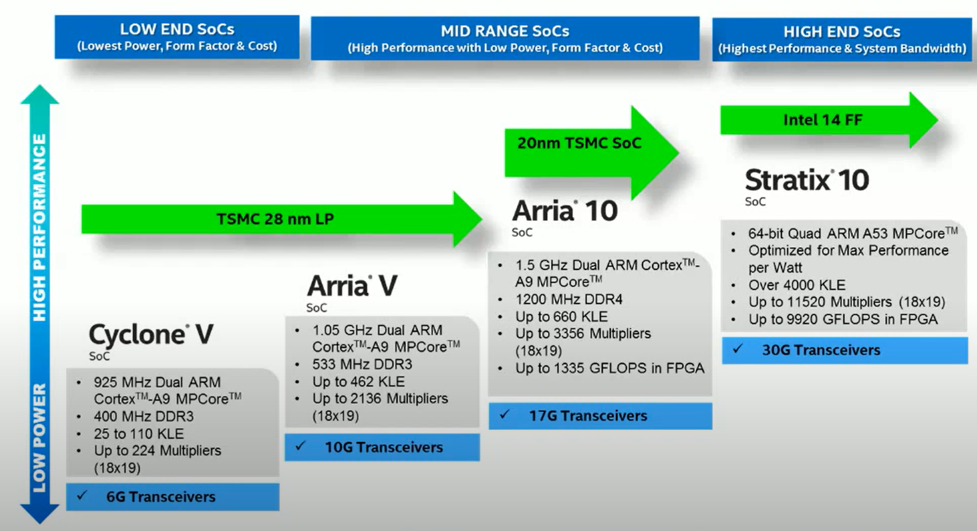
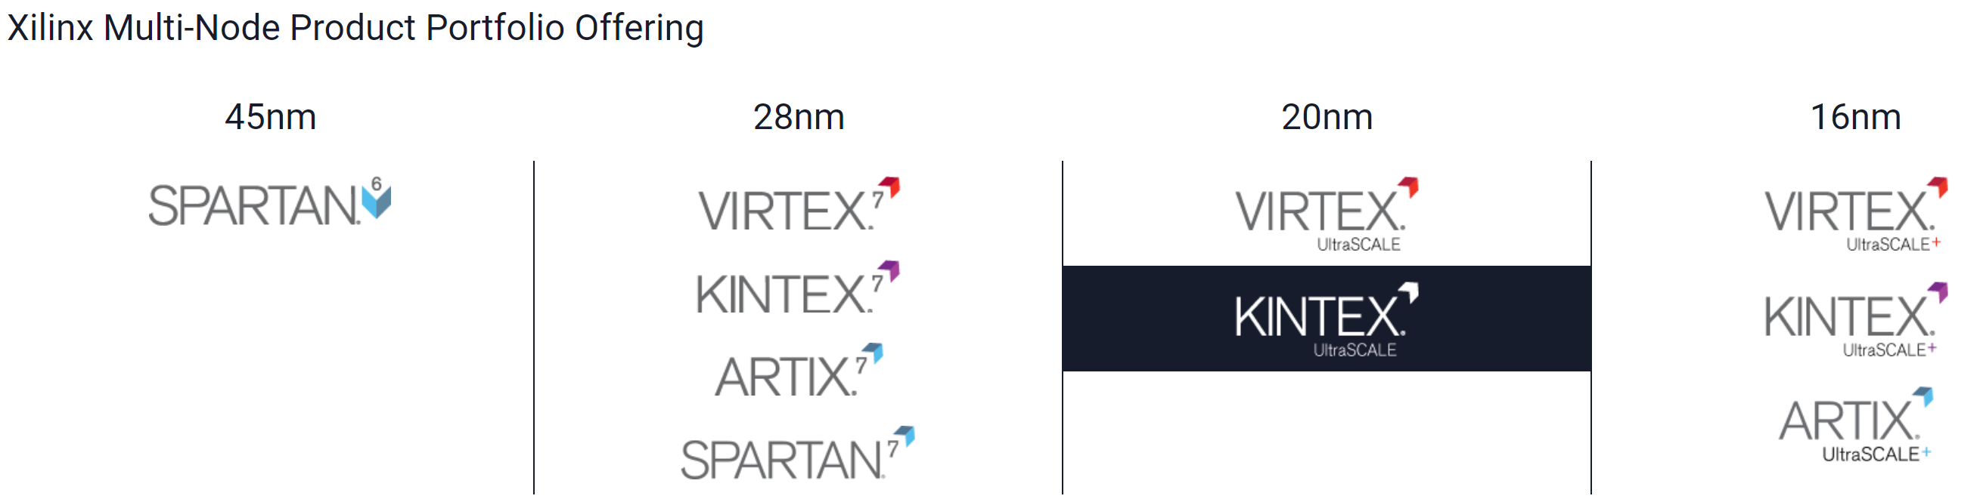
FPGA
Actel → Microsemi(Microchip), 2010, $ 0.42 Billion
Altera → Intel, 2015, $ 16.7 Billion
Xilinx → AMD, 2022, $ 49 Billion (largest chip deal in history)

Slide 8
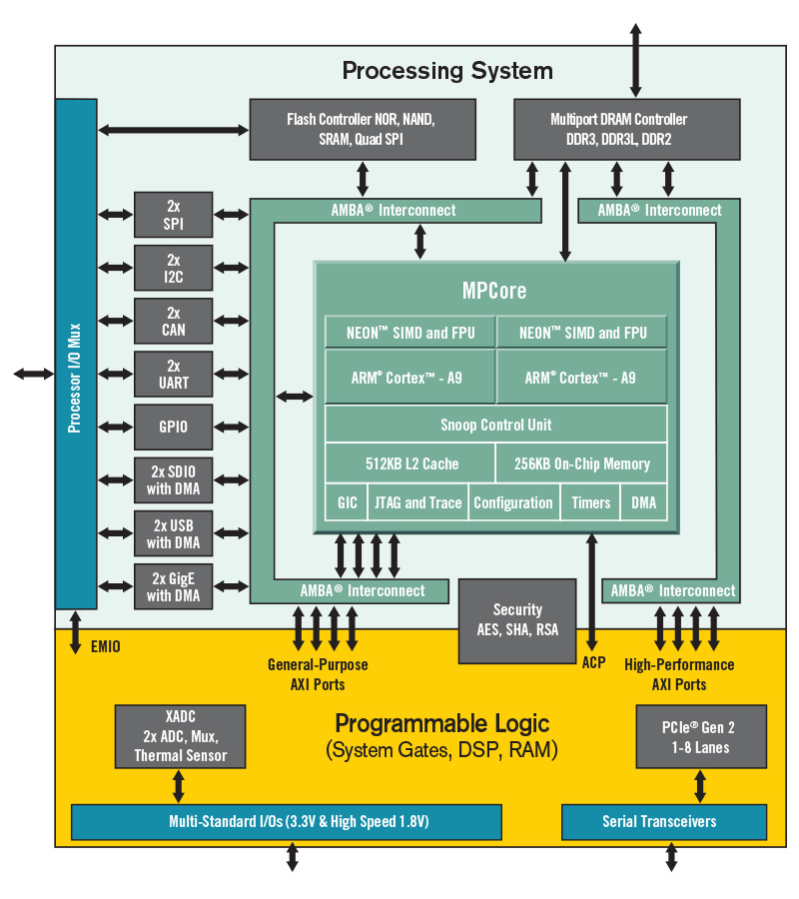
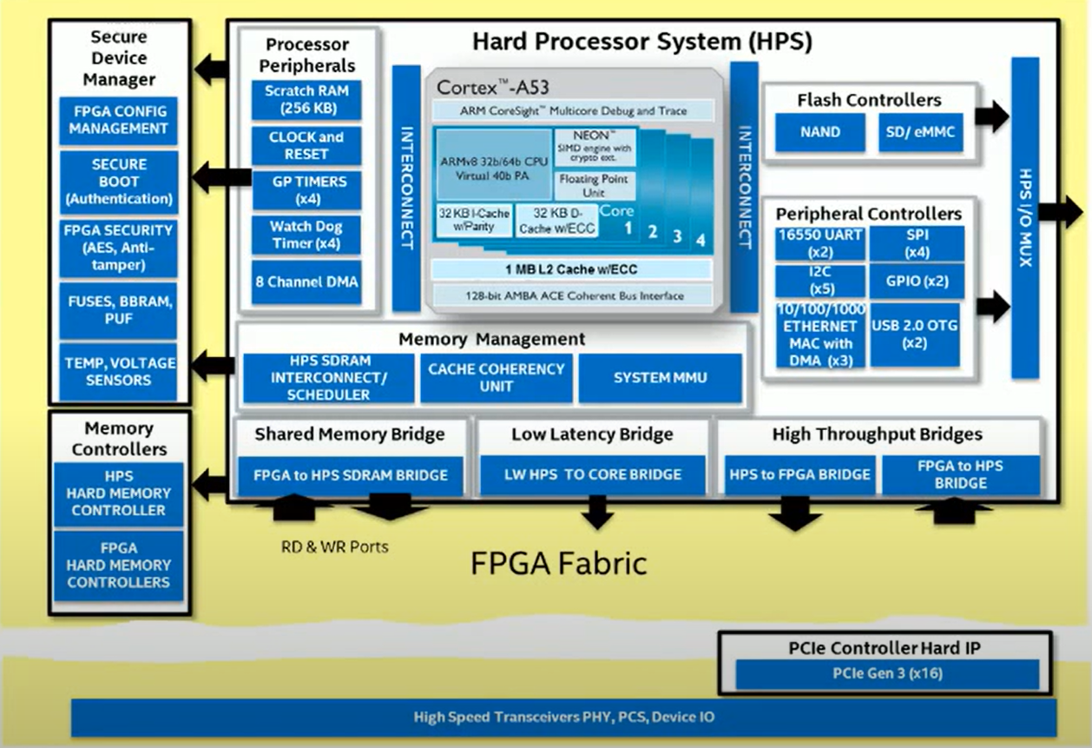
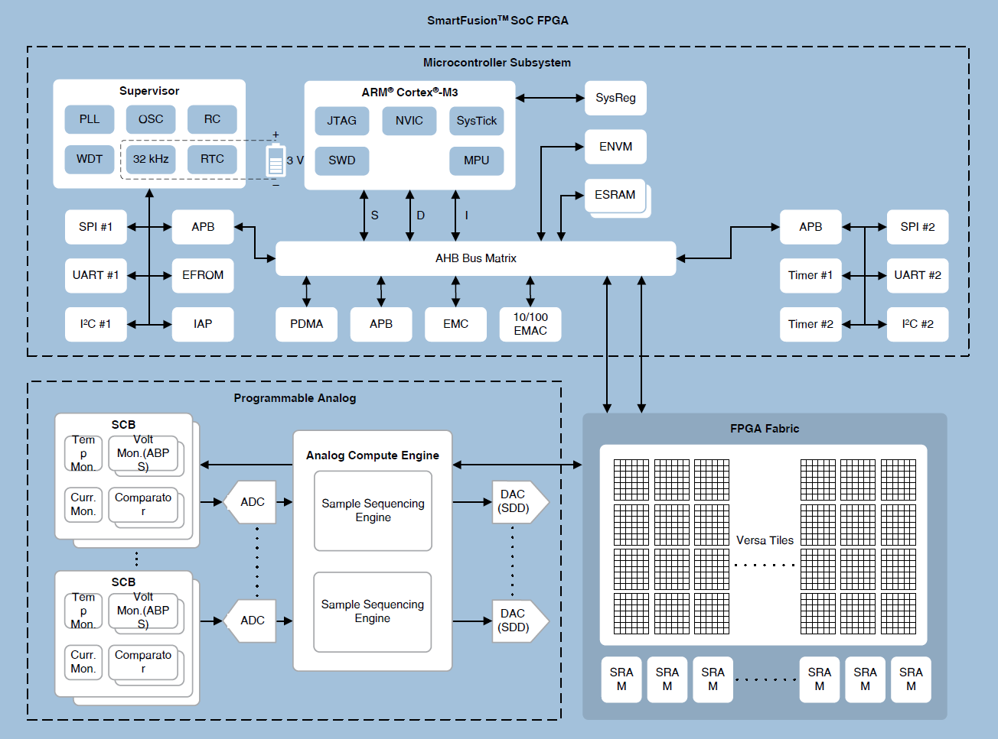
Recent trends
FPGA SoC: Embedded Cores + FPGA on a chip
Xilinx/AMD
Altera/Intel
Actel/Microchip

Slide 9
FPGA vs ASIC
Aspects | FPGA | ASIC
Performance | High | Very high
Power Efficiency | High | Very high
Adaptability & flexibility | Good performance with a broad range of computation; Can be reconfigured with new functionality; Highly reusable | An ASIC only accepts a specific computation; Cannot be reconfigured with new functionality; Low device utilization
Design Cost | Low | Very high, large intellectual work, large cost, long product-to-market time

Slide 10
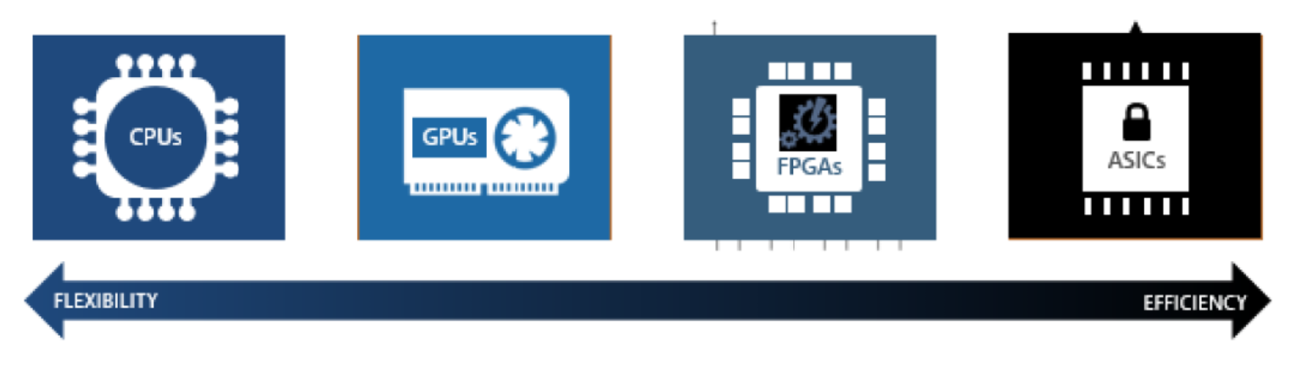
Flexibility vs Efficiency

Slide 11
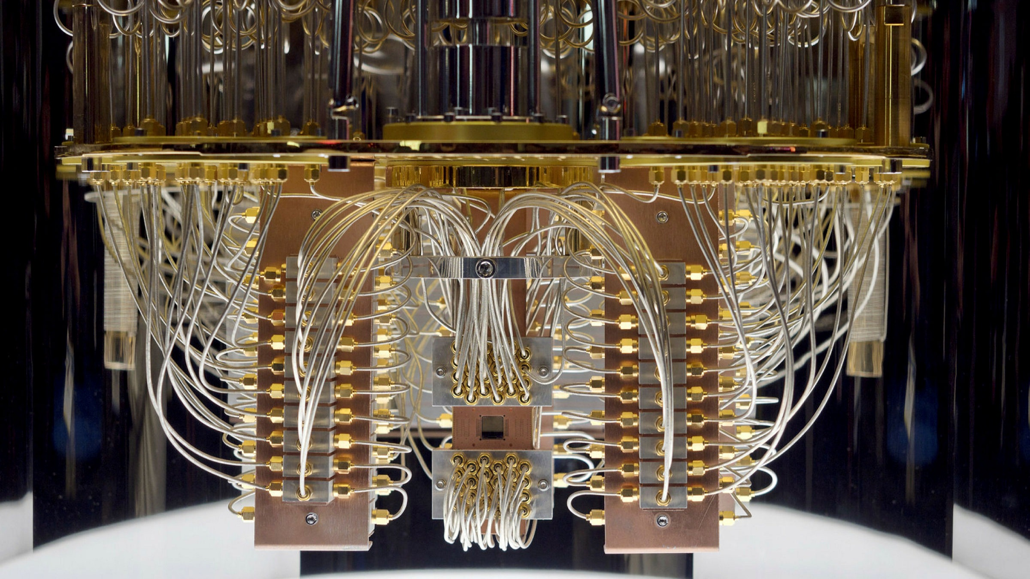
Quantum Computing
Quantum computing is a type of computation that harnesses the collective properties of quantum states, such as superposition, interference, and entanglement, to perform calculations

Slide 12
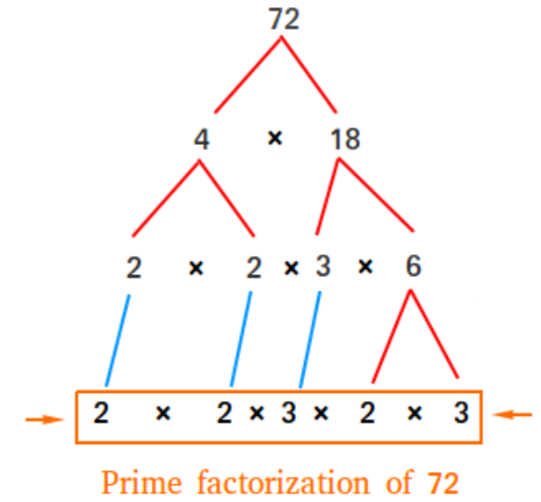
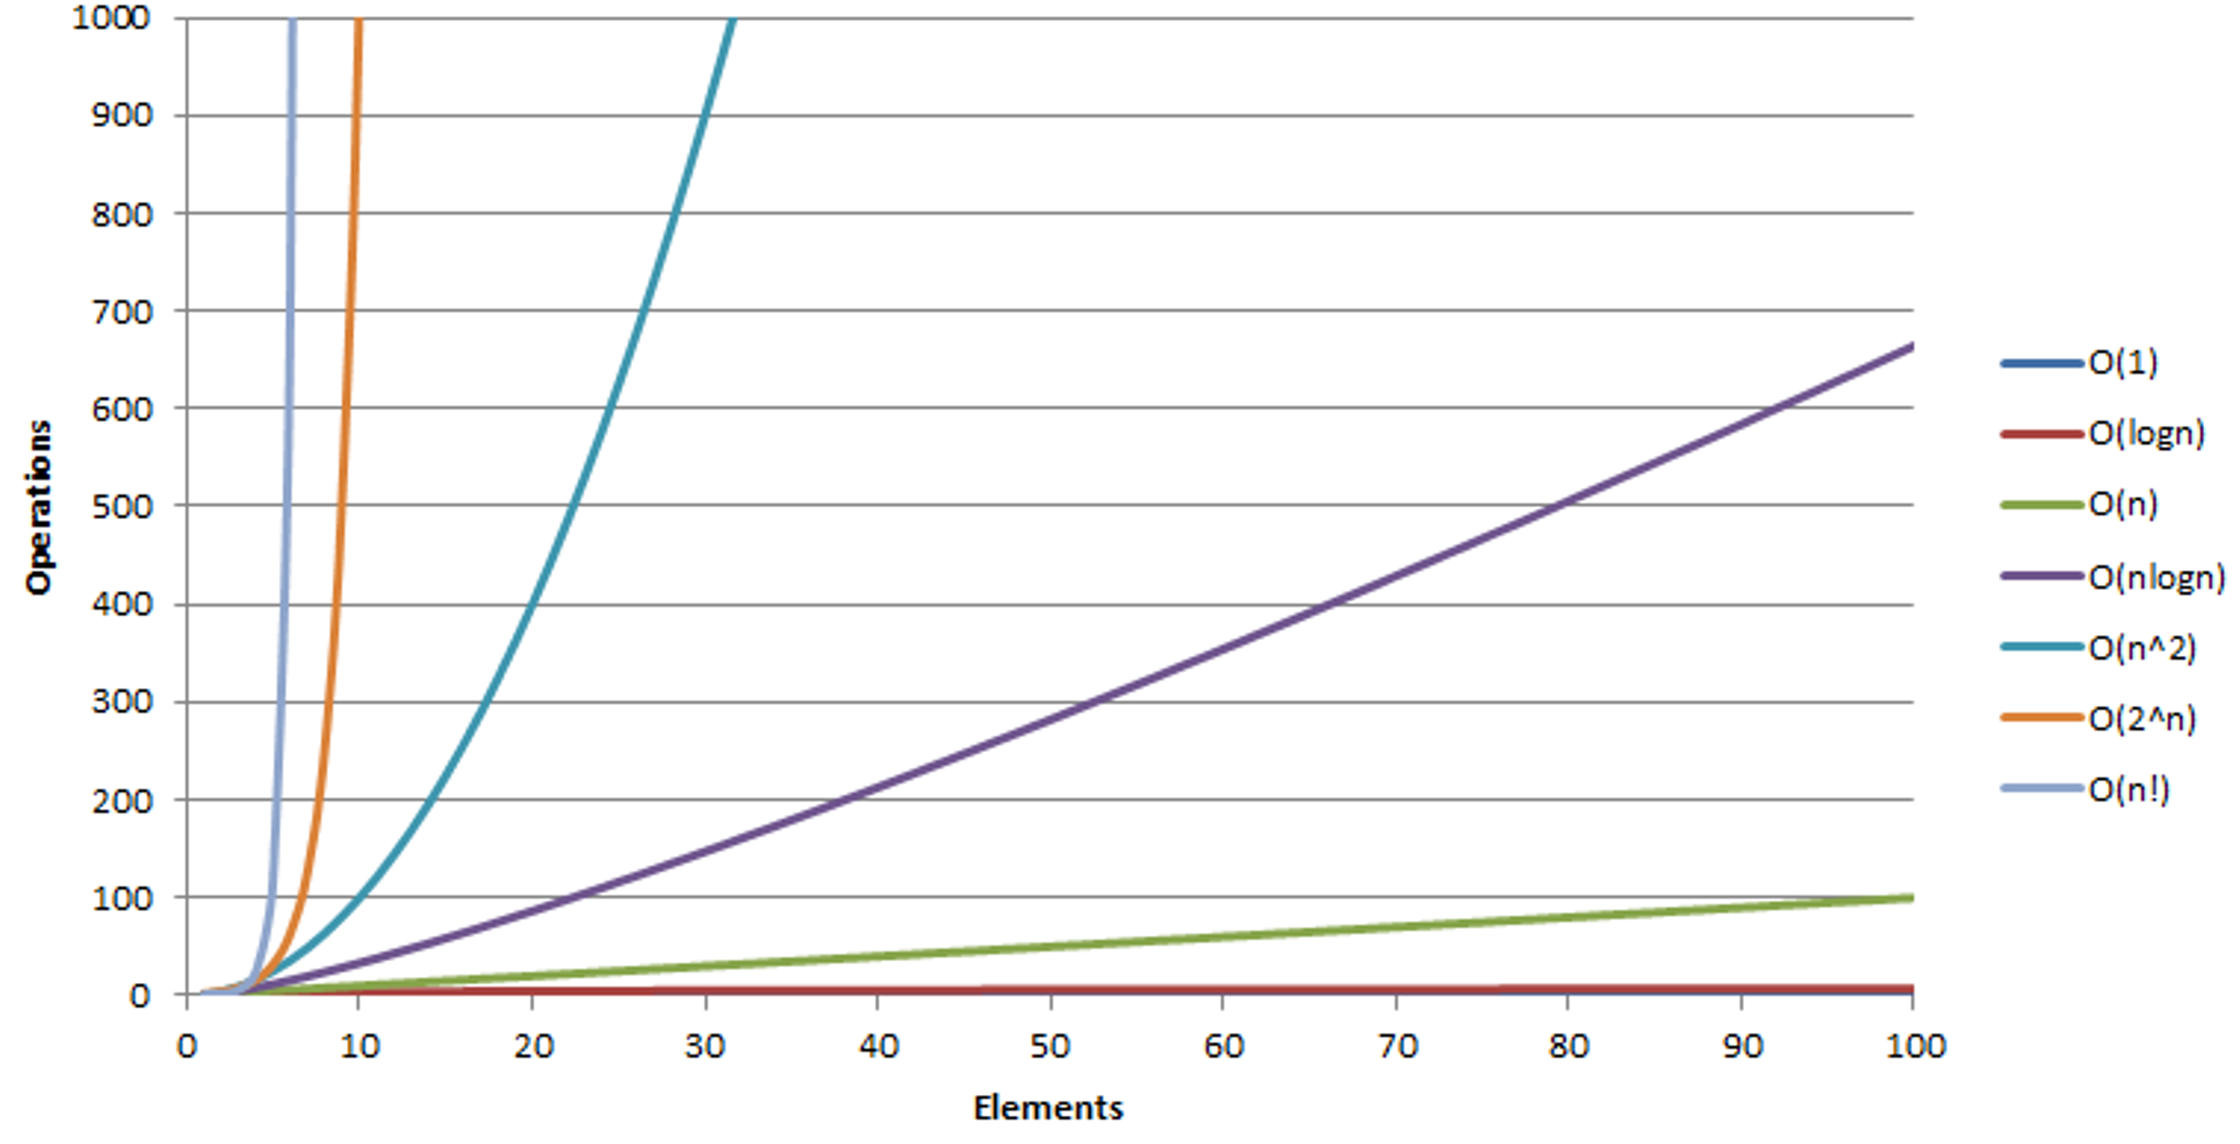
Quantum Computing
Can do some work amazingly faster than conventional computers
E.g., factorization of large numbers
Base of RSA Cryptography
Time complexity: 2^{n}
scale

Slide 13
Quantum Computing
Popular misunderstanding: "a quantum computer is like a massively-parallel classical computer"

Slide 14
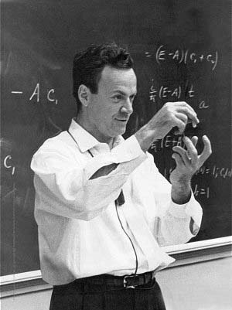
Quantum Computing
“I think I can safely say that nobody understands quantum mechanics” - Richard Feynman
1982 - Feynman proposed the idea of creating machines based on the laws of quantum mechanics instead of the laws of classical physics

Slide 15
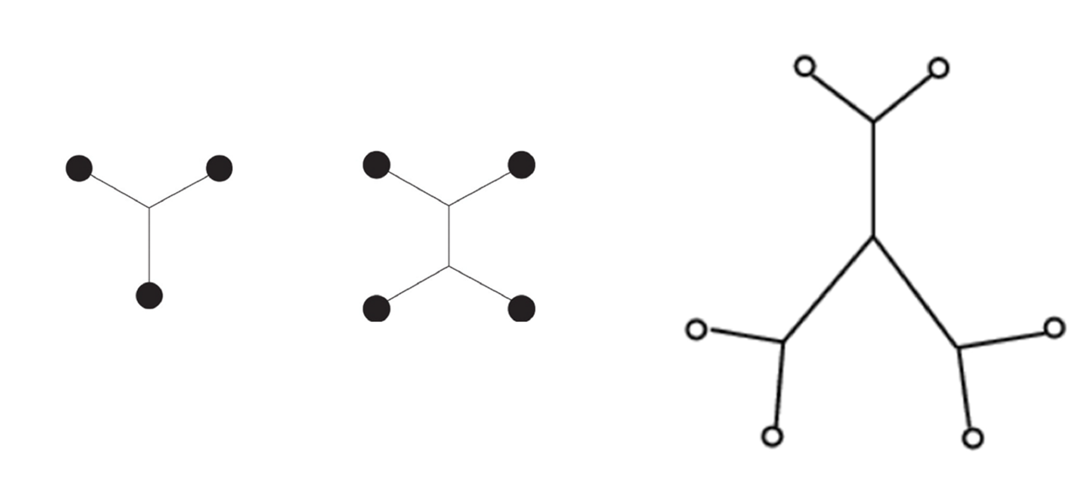
The Steiner Tree Problem
The Steiner Tree Problem
Given an undirected graph, find a tree with the minimal total length that contains all terminals
Exponential complexity on traditional computers
Let’s build a computer to solve this problem efficiently!
https://www.youtube.com/watch?v=PI6rAOWu-Og

Slide 16
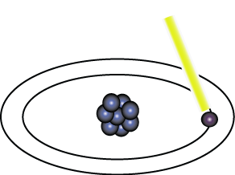
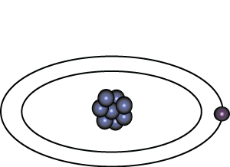
Representation of Data - Qubits
A bit of data is represented by a single atom that is in one of two states denoted by |0> and |1>. A single bit of this form is known as a qubit
A physical implementation of a qubit could use the two energy levels of an atom. An excited state represents |1> and a ground state represents |0>.
Light pulse of frequency λ for time interval t
Excited State
Ground State
Nucleus
Electron
State |0>
State |1>

Slide 17
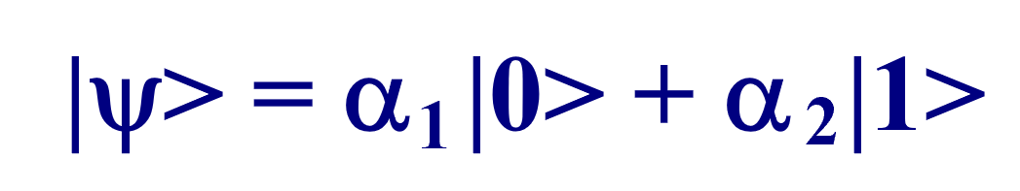
Representation of Data - Superposition
A single qubit can be forced into a superposition of the two states denoted by the addition of the state vectors
where α₁ and α₂ are complex numbers and |α₁|²+ |α₂|²=1
A qubit in superposition is in both of the states |1> and |0> at the same time

Slide 18
Data Retrieval
In general, an n qubit register can represent the numbers 0 through 2^{n-1} simultaneously.
Sound too good to be true?…It is!
If we attempt to retrieve the values represented within a superposition, the superposition randomly collapses to represent just one of the original values.
In our equation: |ψ> = α |0> + α |1> , α represents the probability of the superposition collapsing to |0>. The α’s are called probability amplitudes. In a balanced superposition, α = 1/√2

Slide 19
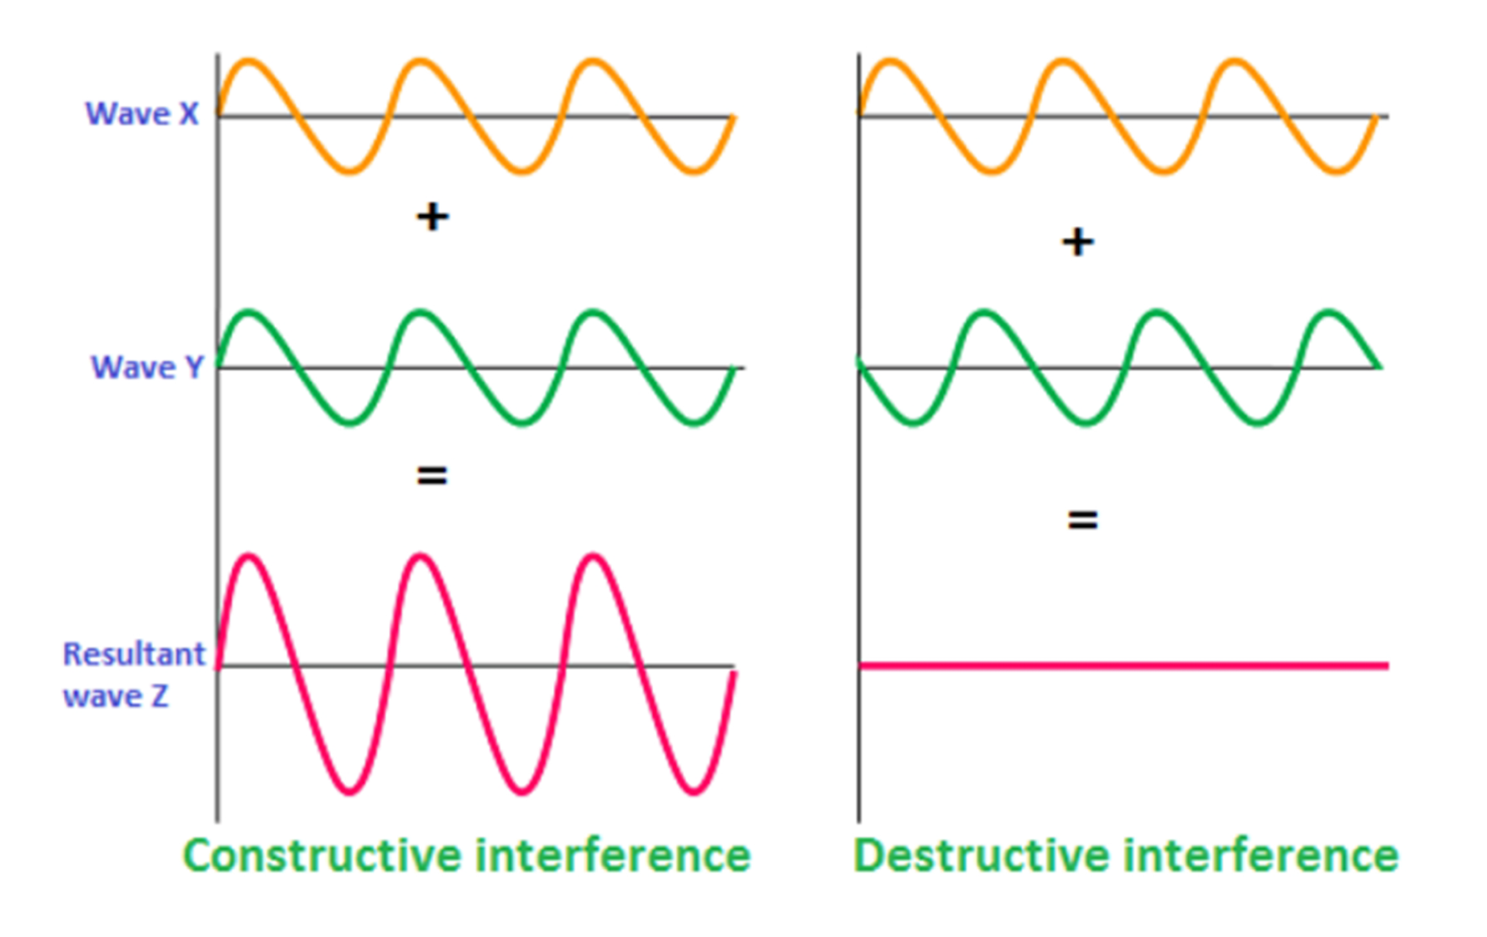
Amplitudes Interference
The key trick in this game:
Let the amplitude of wrong answers deconstruct each other
So the probability to observe correct answers is high

Slide 20
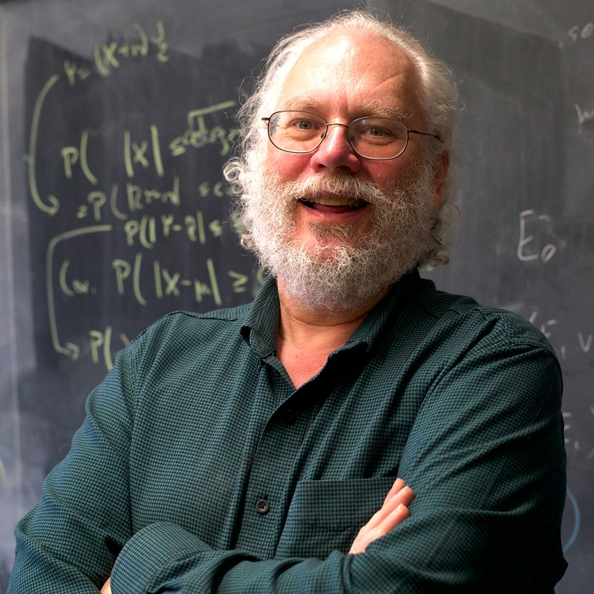
Shor’s algorithm
Developed in 1994 by the American mathematician Peter Shor
Shor’s algorithm shows (in principle,) that a quantum computer is capable of factoring very large numbers in polynomial time.
Shor’s algorithm depends on Modular Arithmetic, Quantum Parallelism and Quantum Fourier Transform

Slide 21

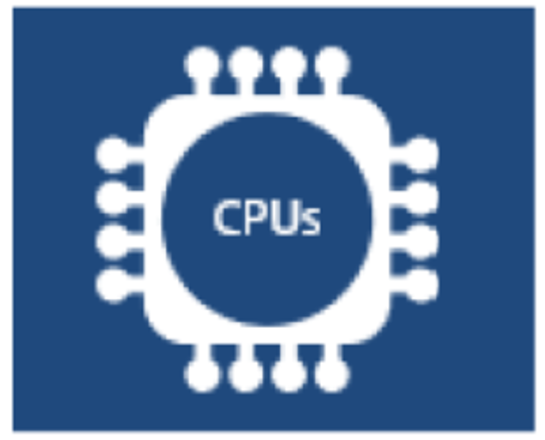
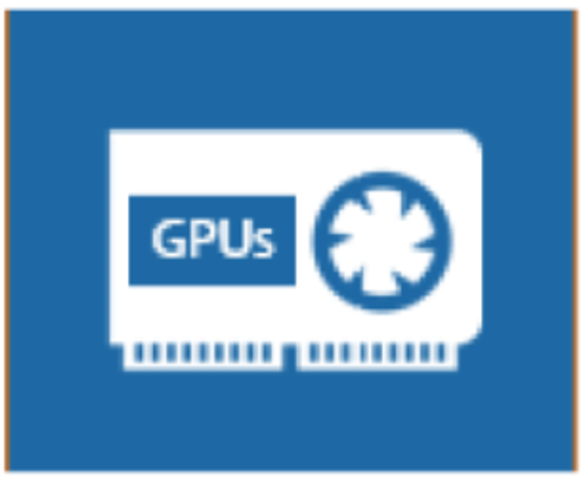
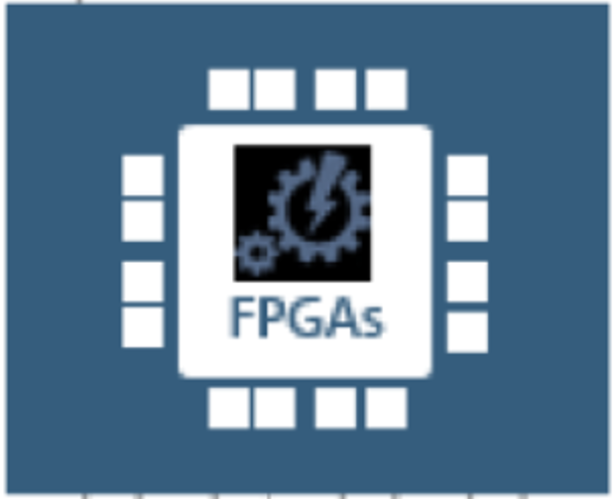
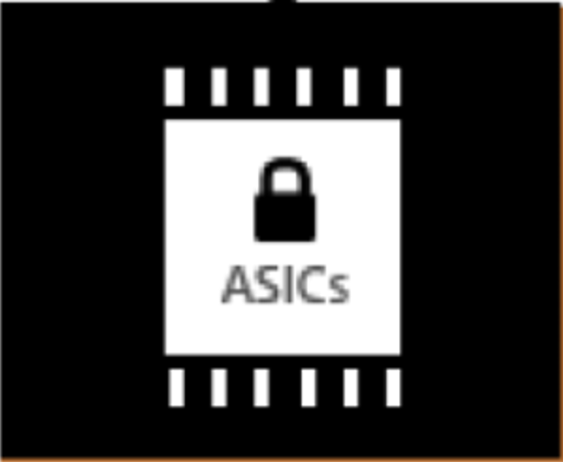
Flexibility vs Efficiency
Where are Quantum Computers?
Flexibility & Ease to use
Performance

Slide 22
Flexibility vs Efficiency
Flexibility & Ease to use
People are working for this
Quantum Computers are currently here!
Performance

Slide 23
Final Exam
Final exam:
2023 Dec. 11, 9:30-11:30
On campus
The same form as midterm
Closed-book, paper based
Calculator allowed
No computer/software

Slide 24
TLQ
Message from the university: “To boost the response rates, teachers have been encouraged to conduct the TLQ evaluation during class session.”
Please do it now, if not yet…

Slide 25
backup

Slide 26
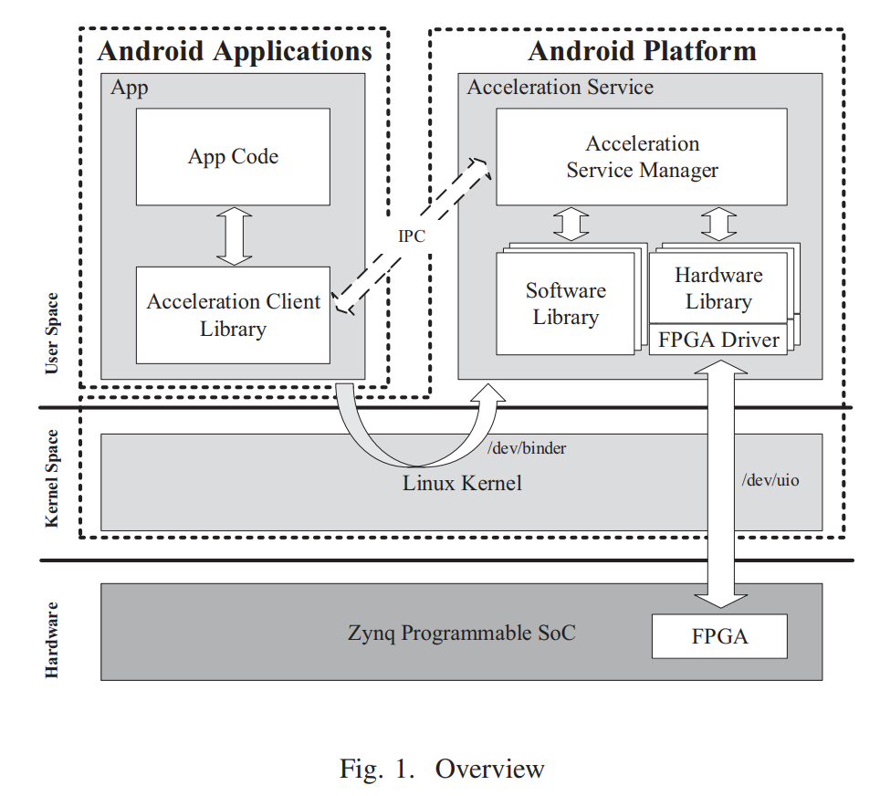
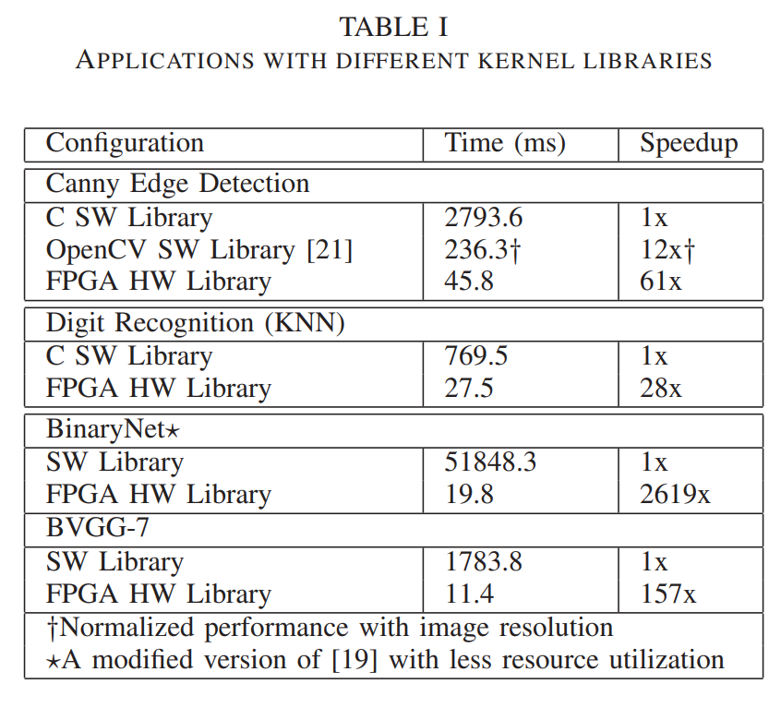
Why FPGA? --- FPGA vs CPU
Better performance on execution time (speed)
H. Ting et al., "System Services for Reconfigurable Hardware Acceleration in Mobile Devices," in 2018 International Conference on ReConFigurable Computing and FPGAs, December 2018.

Slide 27
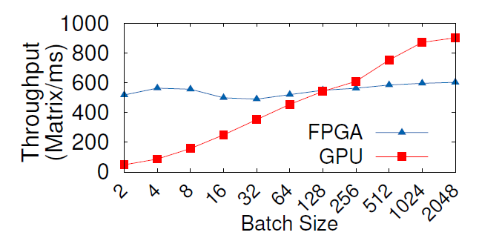
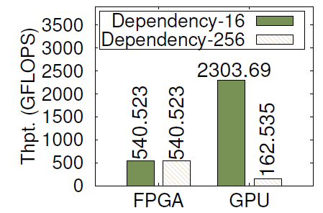
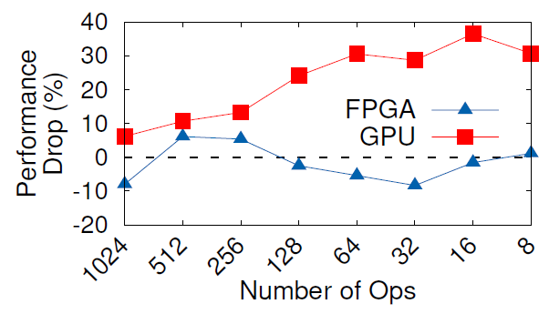
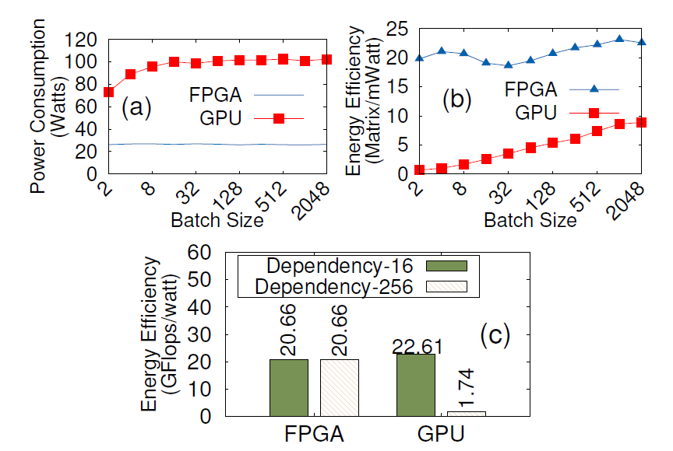
Why FPGA? --- FPGA vs GPU
Aspects | FPGA | GPU
Performance | High performance depending on applications
Adaptability | Good performance with a broad range of computation | Suitable for SIMD workloads; Bad performance with data/control dependent workloads; Low device utilization
Power Efficiency | Generally low-power; High perf./watt | Generally high-power; Low perf./watt
Development cost | High (without existed IP cores) | Generally
Performance of a matrix multiplication program with different batches, GPU has a problem
For high data-dependent workload, FPGA is much better than GPU
For high control-dependent workload, FPGA is much better than GPU
FPGA consumes less power, provides better power efficiency
Biookaghazadeh, Saman, Ming Zhao, and Fengbo Ren. “Are FPGAs Suitable for Edge Computing?”, USENIX Workshop on Hot Topics in Edge Computing (HotEdge 18). 2018.
J. Bodily et al.,“A Comparison Study on Implementing Optical Flow and Digital Communications on FPGAs and GPUs”, ACM Transactions on Reconfigurable Technology and Systems. 2010

Slide 28
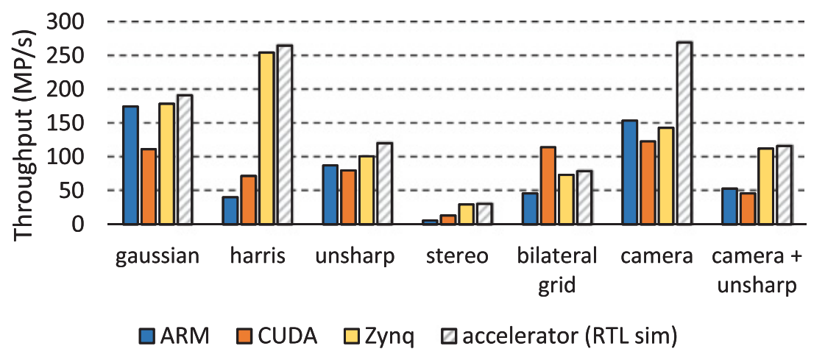
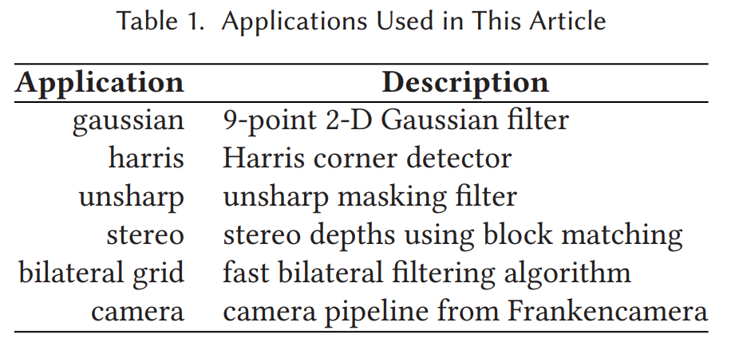
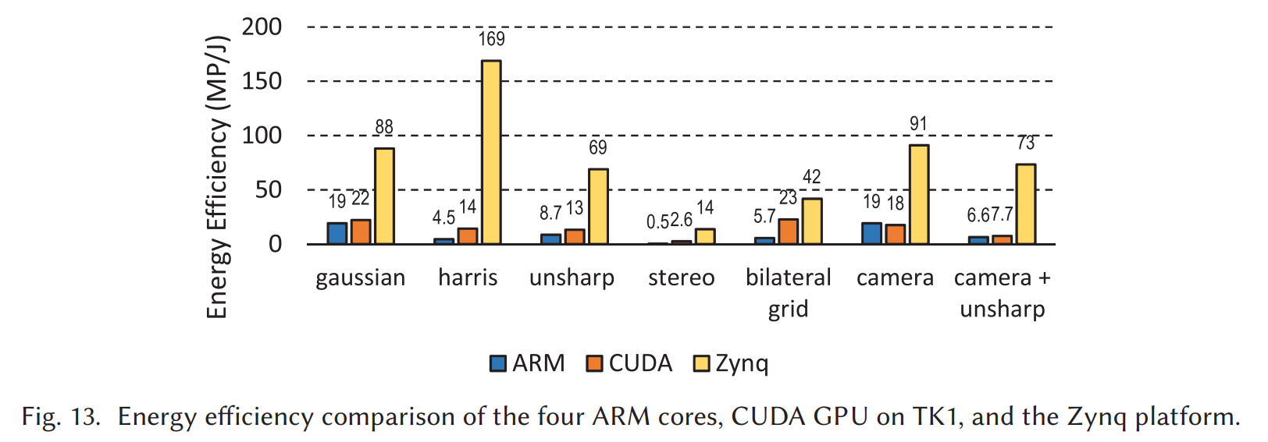
Why FPGA? --- FPGA vs GPU+CPU
Throughput comparison
Application description
FPGA: Xilinx ZC702 evaluation board holding a Zynq XC7Z020 SoC
CPU+GPU: NVIDIA Jetson TK1 board with JetPack 2.0.
Jing Pu, et al,. “Programming Heterogeneous Systems from an Image Processing DSL ”, ACM Transactions on Architecture and Code Optimization, 2017.
Energy efficiency comparison

